Slide 1
PERI-CENE - OVERVIEW
THE CHALLENGE
THE PERI-CENE PROJECT
Climate change hazards & exposure
Policy Lab: 21 partners
In-depth case studies: India & UK
Vulnerability & adaptive capacity
Peri-urban change & expansion
Collaborative governance & action
Spatial analysis tool for global data
Pathways tool for dialogue
With 2 degrees of climate change & current rates of peri-urbanisation, by 2040:
1.2 billion livelihoods are at risk
$14tn of urban assets are at risk
RESULTS & APPLICATIONS
RESEARCH QUESTIONS
Peri-cene will build strategic policy
intelligence in four main sectors:
Urban-rural-environment planning, (mainly public sector);
Finance & real estate, (mainly corporate);
Social & community enterprise, (civic sector);
Resource management & infrastructure, (various).
What are the effects of peri-urban development on climate risk?
What are the effects of climate hazard & exposure on the peri-urban areas?
How to mitigate & adapt to climate impacts & increase resilience of peri-urban development?
(each question is explored for a range of local cases, with a global overview)

Slide 2
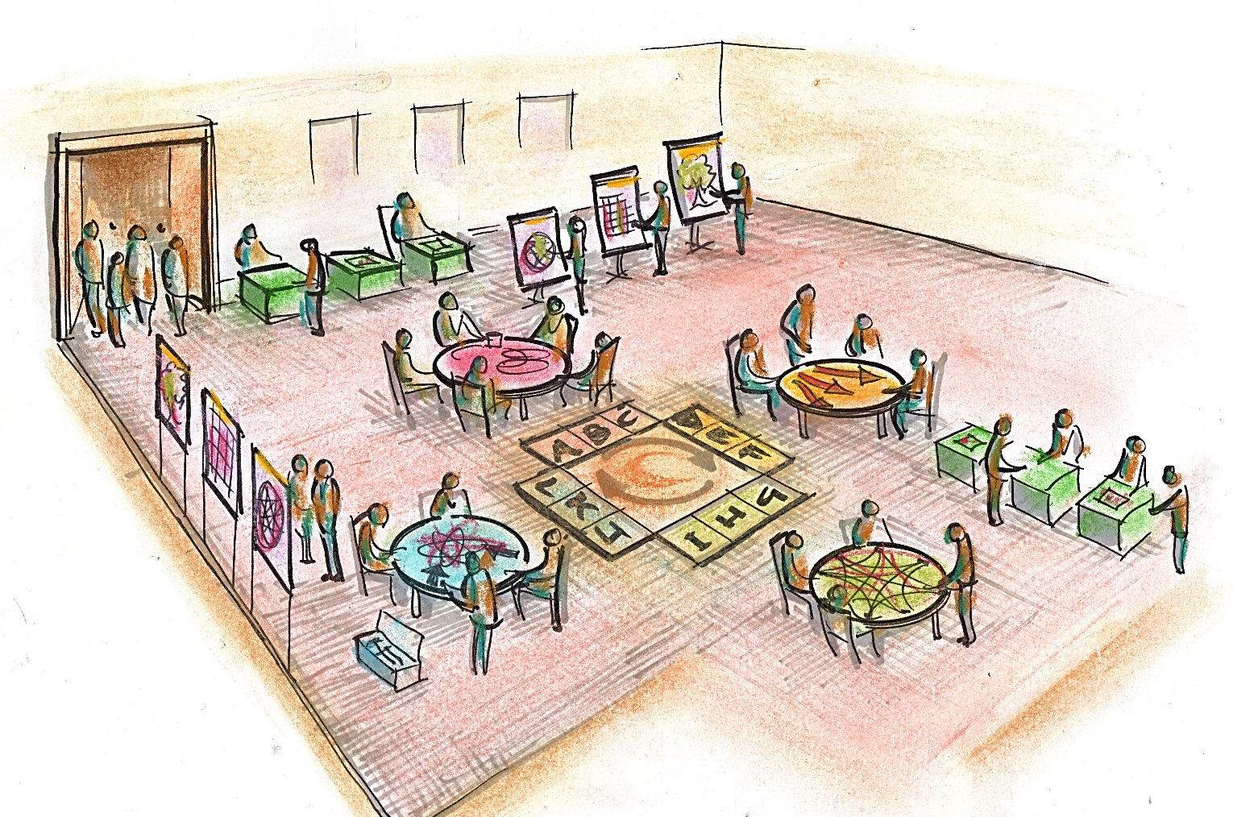
‘P-PATH TOOL’: DELIBERATIVE PROCESS
Using the Synergistic Toolkit in workshop dialogue, enquiries or research programs
Setting up:
Who are the users?
Why are they here?
When is the lunch?
How much time/money?
1) ‘SYSTEM MAPPING’
- first we explore & draw maps of ‘what is our problem’ & ‘how does this system work’?
2) SCENARIO MAPPING - future trends, dynamics, alternative scenarios
(Include visual thinking)
What is the scope?? -
Mode-I for technical
Mode-II for innovation
Mode-III for system trans-formation
(include specialist resources)
B
C
D
E
A
F
L
K
H
G
J
I
3) ‘SYNERGY MAPPING’ –
the creative core of the toolkit, with new collaborations, value-chains, alignments & synergies
Finally - go around the cycle again - or take it out to the world
4) ‘STRATEGY MAPPING’: we converge back to practical plans, policies, actions.

Slide 3
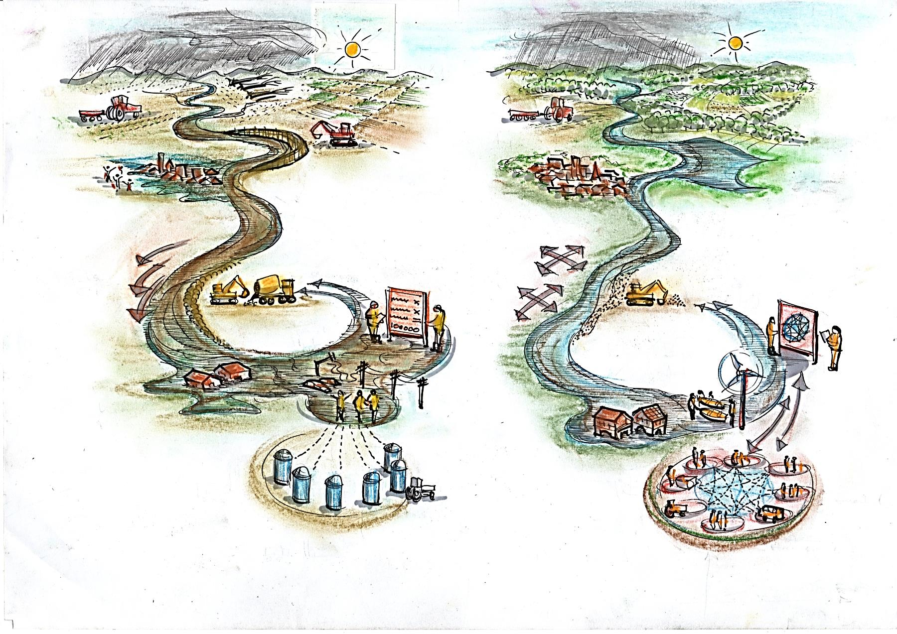
RESILIENCE-III
Example: flood risk, climate adaptation, urban resilience: (based on Arup et al 2014):
‘CLEVER / SMART’ RESILIENCE-I&II
‘WISE’ RESILIENCE-III
Tree cover is depleted leading to rapid soil run-off
Landscape, tree cover & soil structure is enhanced with ecological diversity
Upstream land manage-ment is destructive of soil & landscape structure
Integrated catchment management with all stakeholders
Soft measures for flood containment & adaptation
Hard flood defences are located for commercial interests
cause-effect is multi-way & in our agency
“RISK = 1 in a million” calculation
“RISK = gaps in collaboration” evaluation
cause-effect is one way & out of our control
Houses designed & located for resilience, short / long term
Wrong type of houses in the wrong place & time
Critical infra-structure is vulnerable & fragile
Critical infra-structure is decentralized, robust, empowering of users
Government is all in ‘silos’
...now they’re all talking to each other
Multiple organizations & services with little coordination
Multiple organizations & services are inter-connected & coordinated

Slide 4
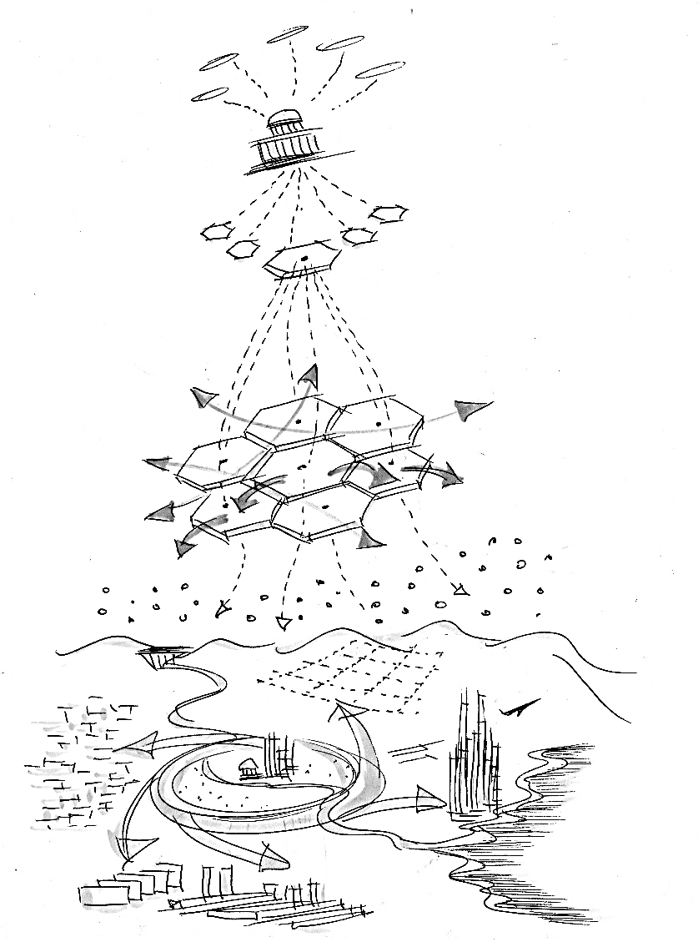
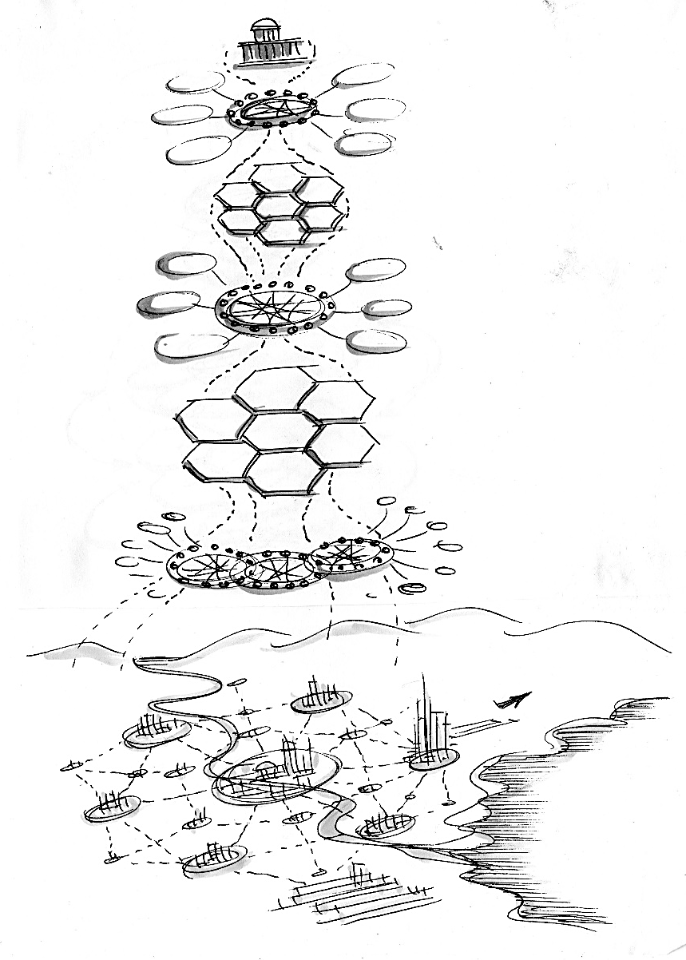
MULTI-LEVEL-III
Transformation from top-down government, towards multi-level / multi-actor governance
a) CITY-REGION SPRAWL - I&II
b) CITY-REGION SYNERGIES - III
Top-down government, remote & disconnected
Collective political intelligence for multiple functions & territories
Cities & regions are a pain in the ***
City-regions are corner-stones of prosperity
Local / regional units can’t respond to global forces.
Co-governance circles with business, technology, media, civic society
Our next mall has 20000 parking places
Citizens are alienated & out of the loop
Citizens are empowered mobilized & in the loop
Outward sprawl of mono-functional landuses
Our next project is a community multi-versity
Integration of green / blue / grey / gold infrastructure
‘Archipelago’ of global business parks / retail parks campuses / hubs
Car dependency, climate / energy vulnerability
Social & economic diversity & self-organization
Multi-modal resilience & urban-rural linkages

